Slide 1
Low Performing Schools in Urban High Poverty Communities
House Committee on Education
November 11, 2014
Notes:
The photo(s) on the report cover will be used on this slide.

Slide 2
Study Mandate
JLARC to study options for restructuring the lowest performing schools or districts
primary reasons for low school performance
successful approaches for urban high poverty schools in Virginia
options used in other states and cities
appropriate criteria for state intervention
For full text see Item 31 of the 2013 Appropriation Act
Notes:
Paraphrase the mandate.

Slide 3
Research Activities
Analysis of improvement at 47 Virginia schools
Interviews with principals and teachers at 9 urban high poverty schools
Analysis of student achievement and school performance data in Virginia (through 2013)
Review of other states and cities using school takeovers
Review of research literature

Slide 4
In Brief
Lower school performance is strongly associated with high poverty, but high poverty schools can perform relatively better with sound instructional practices, effective staff, and support services.
The state can facilitate improvement through stronger memoranda of understanding and additional resources and flexibility for low performing schools.
Notes:
State the “bottom line” or takeaway message of the presentation in one or two sentences.

Slide 5
In This Presentation
Background
Performance of Urban High Poverty Schools
Improving Virginia’s Low Performing Schools
Notes:
List the major sections of the presentation beginning with “Background.” Use black text for the upcoming section and 35% gray for the rest.
Keep these section labels brief.
Repeat this slide before beginning each new section, changing the text colors appropriately.
A short presentation may include only one of these slides. In this case, use black text for all of the sections.

Slide 6
Student Achievement Influenced by Community, Family, and Schools
Notes:
Emphasize its primarily family background, especially household income

Slide 7
Virginia Schools Must Meet SOL Pass Rates and Graduation Rates for Accreditation
 |  | Fully Accredited | Accredited with Warning
SOL | English | ≥ 75% | < 75%
 | Math | ≥ 70 | < 70
 | Science | ≥ 70 | < 70
 | History | ≥ 70 | < 70
 | Graduation index | ≥ 85 | < 82
Accreditation denied: school fails to be fully accredited 4 consecutive years
Notes:
Present general background information in 3-5 slides.
But present background information that is specific to an individual section at the beginning of that section of the presentation.
Use a descriptive or telegraphic title for these slides.

Slide 8
In This Presentation
Background
Performance of Urban High Poverty Schools
Improving Virginia’s Low Performing Schools
Notes:
List the major sections of the presentation beginning with “Background.” Use black text for the upcoming section and 35% gray for the rest.
Keep these section labels brief.
Repeat this slide before beginning each new section, changing the text colors appropriately.
A short presentation may include only one of these slides. In this case, use black text for all of the sections.

Slide 9
Finding
Low school performance in Virginia is strongly associated with high poverty.
Notes:
Most presentations will include at least one “Finding” slide. (Presentations on special reports such as on State spending or VRS may not include findings).
A finding is a conclusion drawn from the evidence, not a simple statement of fact.
Use complete sentences to state a finding.
You can list more than one finding on a slide (change title to “Findings”).

Slide 10
Poverty Poses Significant Challenges for Virginia’s Urban Students
Students in high poverty schools more likely to
miss school days
change schools during the school year
Poverty cited as significant challenge by teachers and principals
Students regularly come to school unprepared for learning because of difficulties at home
Notes:
Give these slides a telegraphic title (expresses a complete thought in a concise manner).

Slide 11
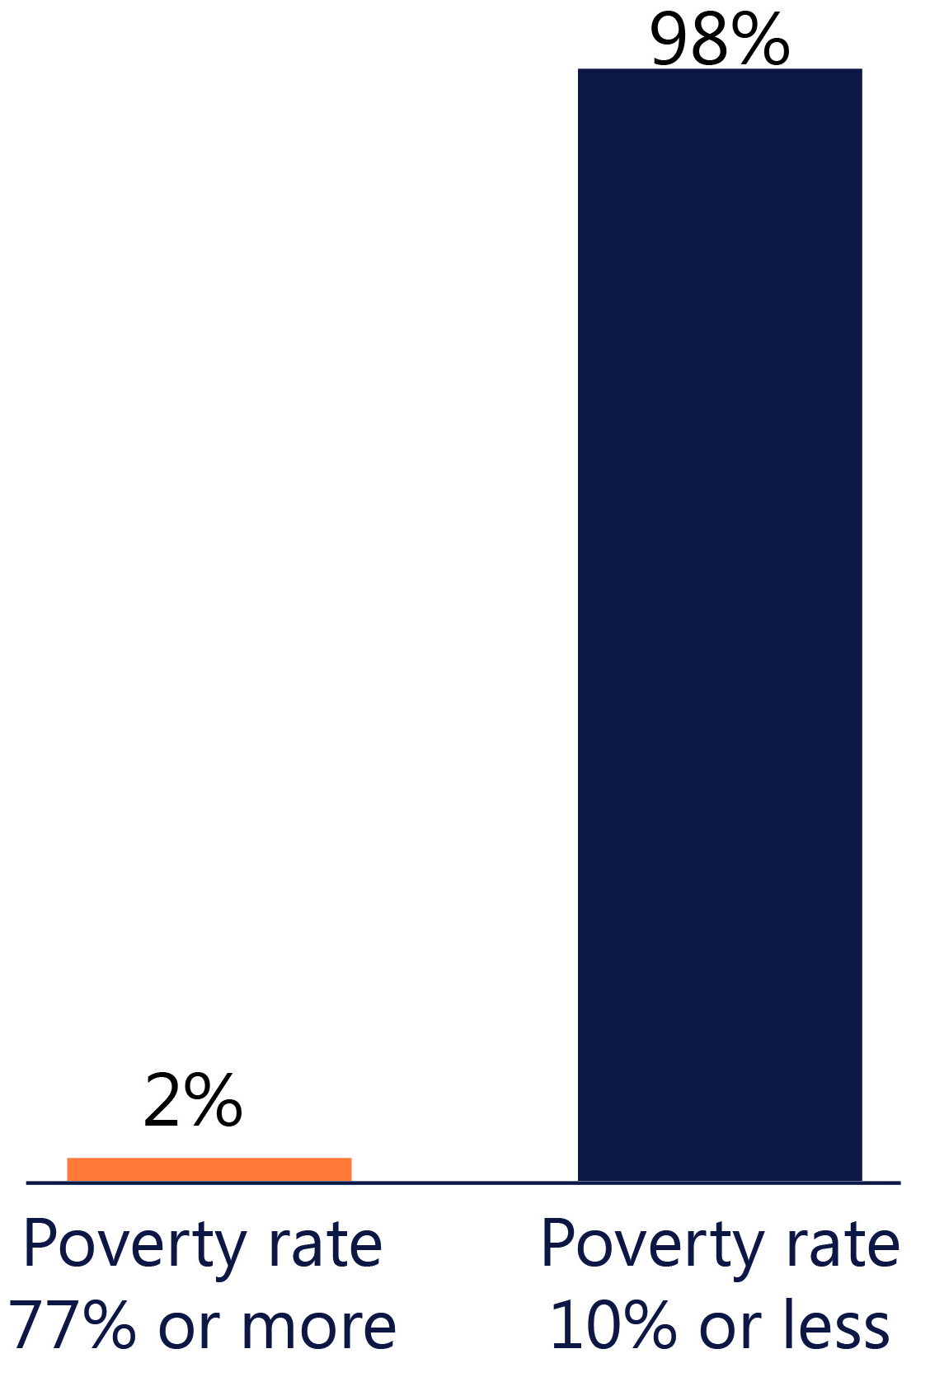
High Poverty Schools Have Lower English SOL Test Scores

Slide 12
Low Performing Schools Often Lack a Sufficient Number of Effective Teachers
7 of 11 low performing schools reported lacking enough effective teachers
Two challenges with removing ineffective teachers
Time and documentation required for termination
Difficulty recruiting quality teachers

Slide 13
Finding
Effective staff, recommended instructional practices, and support services have helped a few urban high poverty schools perform moderately well.
Notes:
Most presentations will include at least one “Finding” slide. (Presentations on special reports such as on State spending or VRS may not include findings).
A finding is a conclusion drawn from the evidence, not a simple statement of fact.
Use complete sentences to state a finding.
You can list more than one finding on a slide (change title to “Findings”).

Slide 14
Staff at Higher Performing Schools Use Recommended Instructional Practices
Effective teachers
Regular use of student performance data
Team approach to teaching
Ongoing professional development
Principal serves as instructional leader
Limited turnover among teachers and principals

Slide 15
Higher Performing Schools Provide Support Services to Students
Achievable Dream schools
Partner with local businesses and City of Newport News
Broad range of support services
Character education
Mentoring and monitoring
Medical and personal care services

Slide 16
Finding
Prior school improvement efforts in Virginia have had a moderately positive impact.
Notes:
Acknowledge it is challenging to draw a very clear cause and effect about what specific role each improvement effort has had.

Slide 17
Low Performing Schools Have Been Subject to State Assistance and Requirements
MOU with Board of Education
Required to implement corrective actions
Restructuring of school (in lieu of MOU)
Federal School Improvement Grant
Required to implement approved reform model

Slide 18
Moderate Improvement, But Most Schools Still Remained Low Performing
About 40% of schools improved relative to the state average
Nearly half of schools were still substantially below the state average score

Slide 19
In This Presentation
Background
Performance of Urban High Poverty Schools
Improving Virginia’s Low Performing Schools
Notes:
List the major sections of the presentation beginning with “Background.” Use black text for the upcoming section and 35% gray for the rest.
Keep these section labels brief.
Repeat this slide before beginning each new section, changing the text colors appropriately.
A short presentation may include only one of these slides. In this case, use black text for all of the sections.

Slide 20
Finding
State takeover will not necessarily lead to greater school improvement than past Virginia efforts.
Notes:
Most presentations will include at least one “Finding” slide. (Presentations on special reports such as on State spending or VRS may not include findings).
A finding is a conclusion drawn from the evidence, not a simple statement of fact.
Use complete sentences to state a finding.
You can list more than one finding on a slide (change title to “Findings”).

Slide 21
Insufficient Evidence in Most States Whether Takeover Has Been Successful
Lack of sufficient evidence of improvement from older takeover initiatives
New Jersey
Illinois
Some takeovers with state divisions too recent to assess
Tennessee
Michigan
Notes:
Emphasize this is not because we didn’t look hard enough or ran out of time. The evidence in many cases just isn’t there.

Slide 22
Moderate Improvement in Louisiana RSD, But Similar to Results in Virginia
44% of Louisiana RSD schools taken over improved relative to takeover average
Nearly half rated “D” or “F”
In both states, moderate improvement in some schools
At most schools subject to improvement efforts, performance remains low
RSD = Recovery School District

Slide 23
Finding
The state can facilitate improvement without taking over low performing schools.
Notes:
Most presentations will include at least one “Finding” slide. (Presentations on special reports such as on State spending or VRS may not include findings).
A finding is a conclusion drawn from the evidence, not a simple statement of fact.
Use complete sentences to state a finding.
You can list more than one finding on a slide (change title to “Findings”).

Slide 24
Accountability for Improving School Performance is Essential
State has constitutional obligation to ensure high quality K-12 education
Ability to exercise greater control over low performing schools is critical

Slide 25
Virginia Has Used MOUs to Support Prior Improvement Efforts
Local school divisions have had final authority
State played more of an advisory role
Consultation on instructional programs and personnel
Provide documentation on planning and actual expenditures

Slide 26
Stronger MOUs Would Compel Better Decisions, But State Role Needs to Be Established
Use VDOE expertise and insight when necessary to require—rather than merely suggest—changes
Binding state authority to override local division on key budgetary, personnel, and instructional decisions
Would require changes to Code and Constitution of Virginia
Notes:
Emphasize that DOE can in certain cases have expertise to make more effective decisions than school division

Slide 27
Recommendations
State Board of Education should enter into mandatory MOUs with school divisions that meet criteria for low performance.
The General Assembly may wish to consider
amending the Code to give the Board legal authority for such MOUs
amending the Constitution to provide such authority, subject to voter approval
Notes:
These slides are REQUIRED if the report contains recommendations. Do not change the slide title.
Use complete sentences.
Paraphrase long recommendations.

Slide 28
Finding
The state can provide additional resources and flexibility to assist low performing schools.
Notes:
Most presentations will include at least one “Finding” slide. (Presentations on special reports such as on State spending or VRS may not include findings).
A finding is a conclusion drawn from the evidence, not a simple statement of fact.
Use complete sentences to state a finding.
You can list more than one finding on a slide (change title to “Findings”).

Slide 29
Teachers Can Be Trained Specifically for Urban High Poverty Schools
Teach for America provides short-term solution
Costs local school division up to $5,000 per teacher placed
Urban teacher residency programs provide longer-term solution
Approximately $480K in planning costs and $40K per teacher placed

Slide 30
Recommendations
The General Assembly may wish to consider providing grants to local school divisions that place Teach for America teachers in low performing schools.
The General Assembly may wish to consider providing grants to higher education institutions and local school divisions to develop teacher residency programs.
Notes:
These slides are REQUIRED if the report contains recommendations. Do not change the slide title.
Use complete sentences.
Paraphrase long recommendations.

Slide 31
Non-Traditional Models Can Improve Instruction and Student Support
Year-round schools
Support services for students in poverty
Achievable Dream model: smaller student body, per-student expenditures ≈ 20% higher
High quality charter schools
Can improve high poverty schools, according to research literature
Requires rigorous evaluation of charter vendors

Slide 32
Key Findings
Lower school performance is strongly associated with high poverty, but high poverty schools can perform relatively better.
Accountability is essential for improving performance; binding MOUs could help.
The state can provide additional resources and flexibility to assist low performing schools.
Notes:
This slide is REQUIRED for most presentations. Do not change the title.
Include all or most of the Key Findings from the Report Summary. In most cases, however, make the wording more concise than in the report.

Slide 33
Final Report
Final report posted on JLARC website
http://jlarc.virginia.gov/
Notes:
This is the last slide in the presentation.

